Slide 1



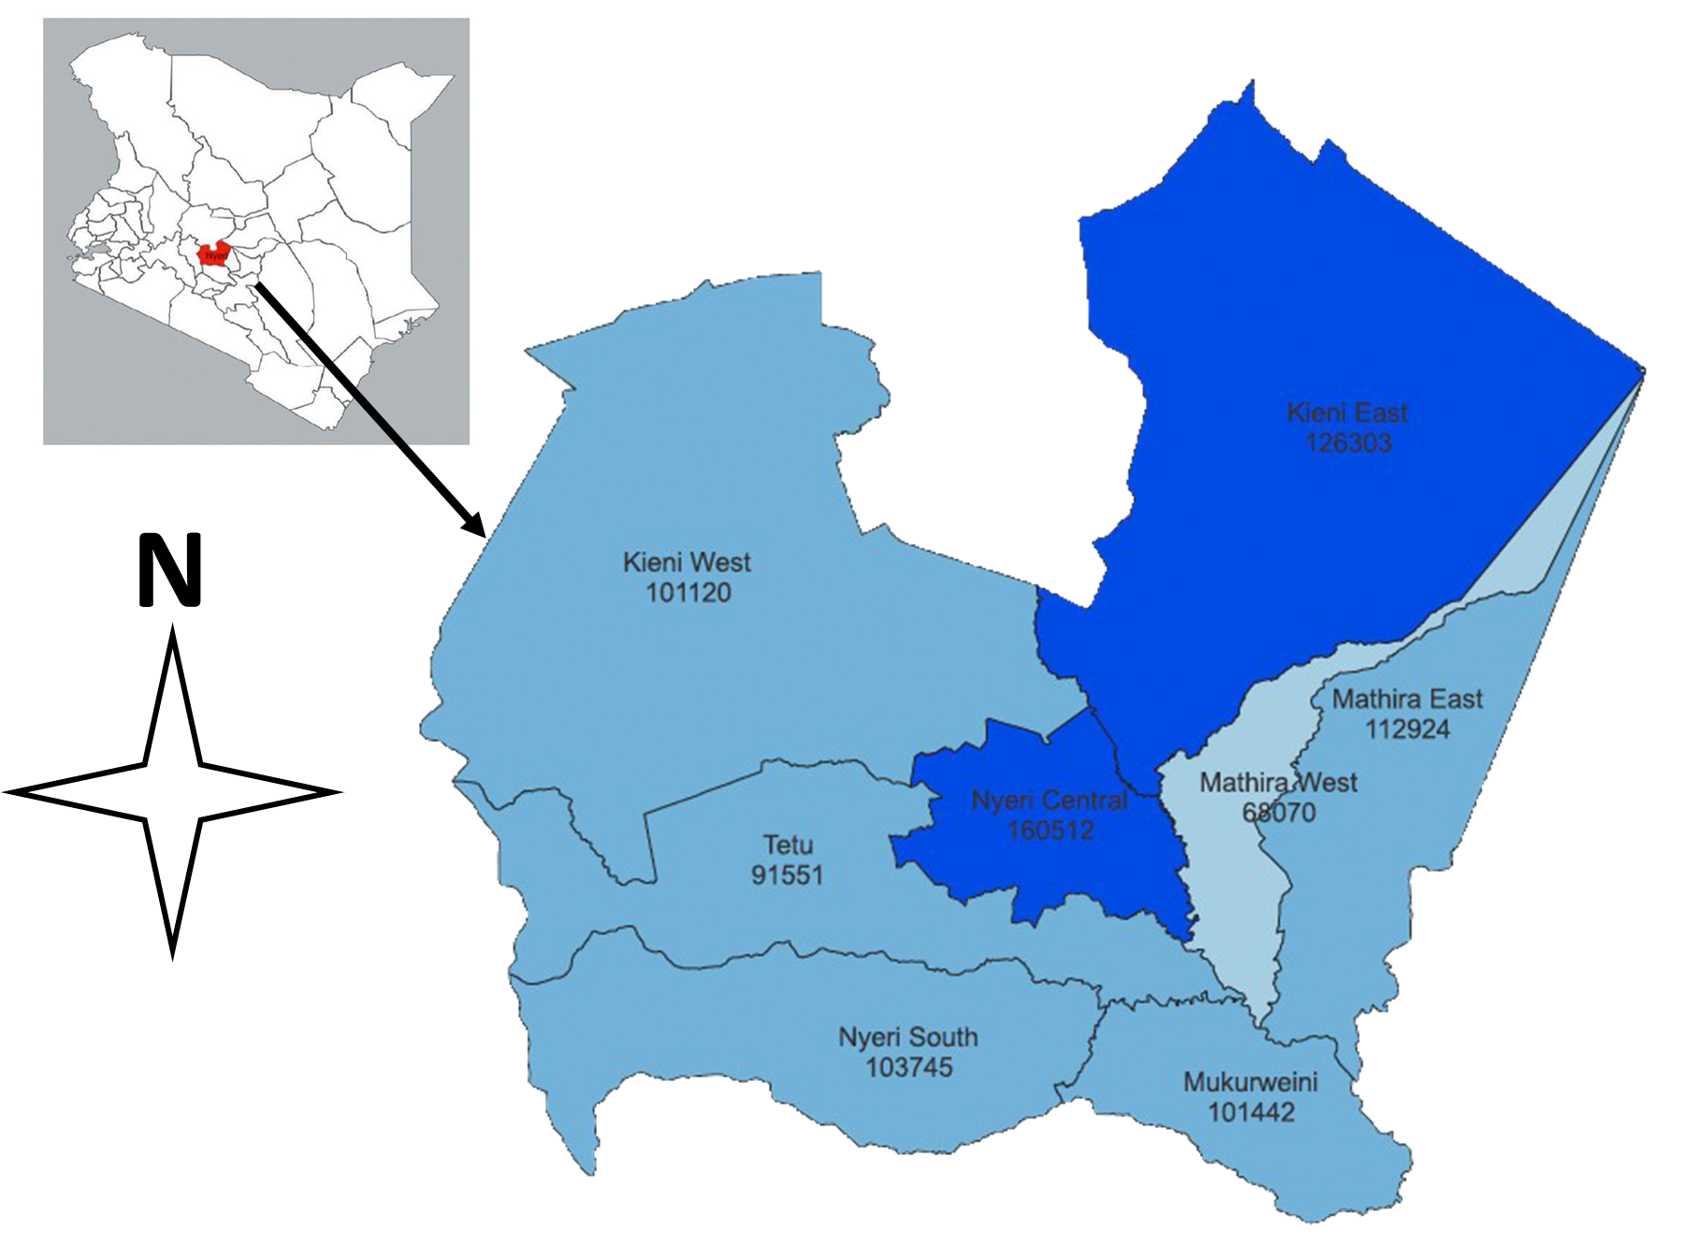
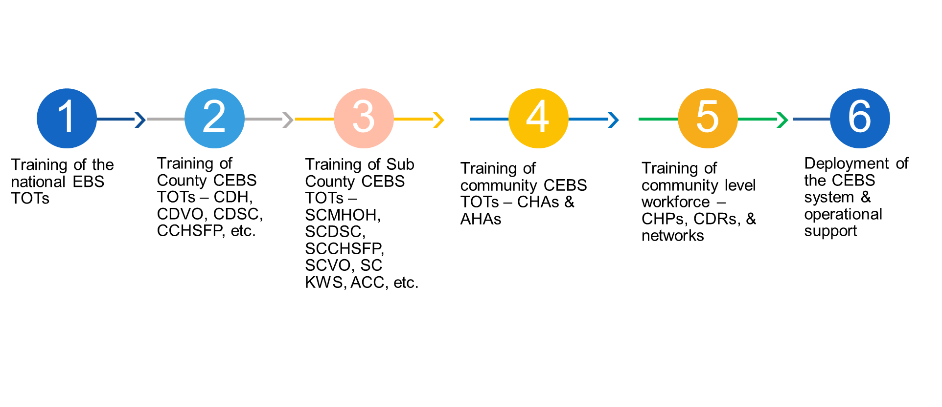
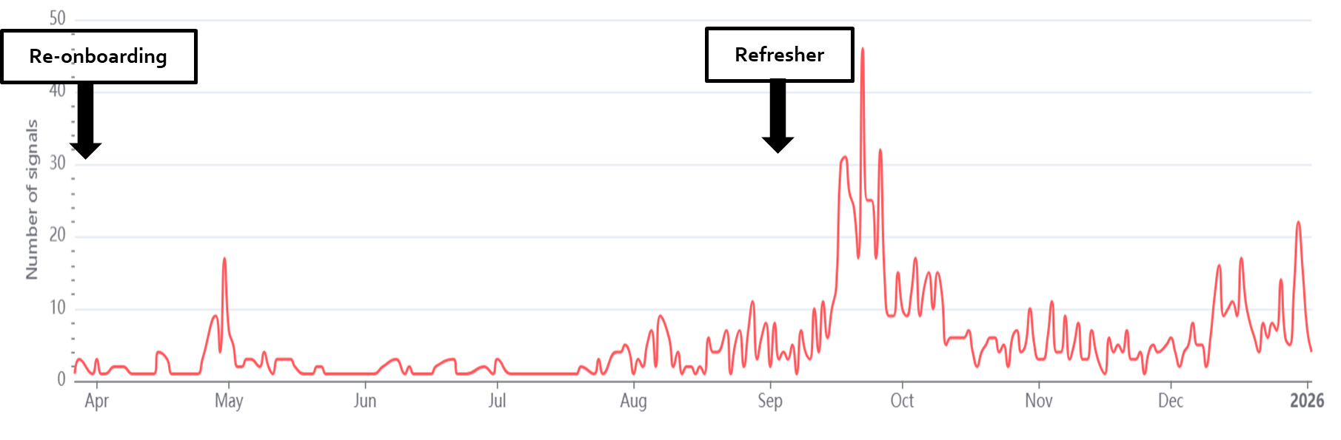
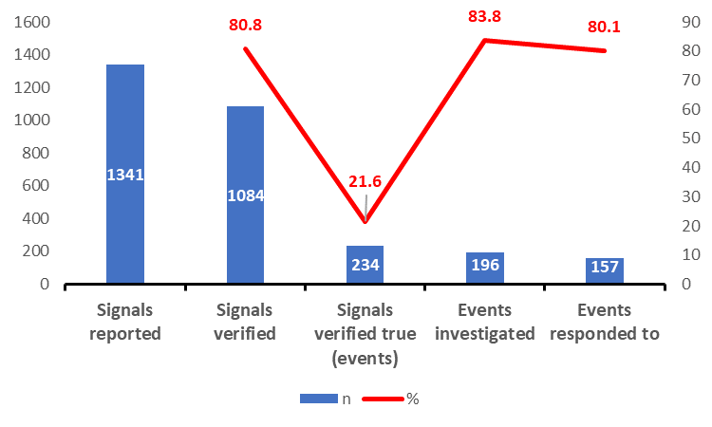
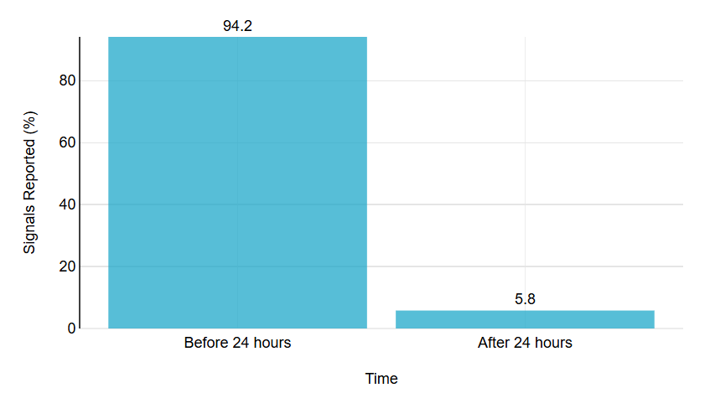
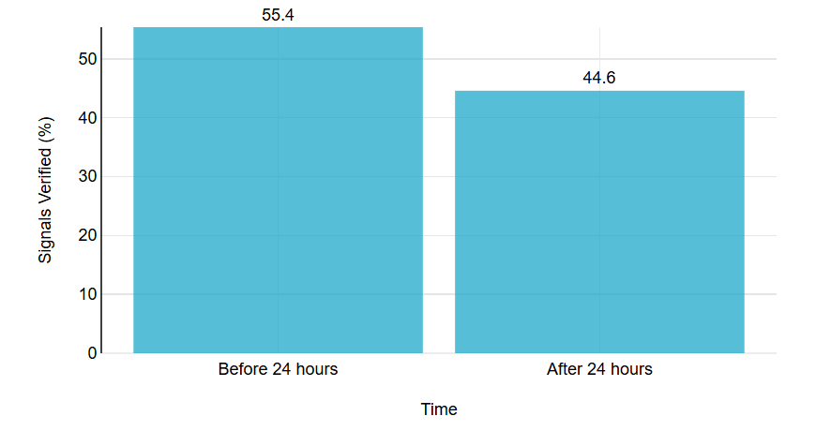
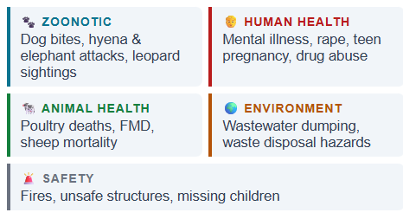



Advancing One Health through Community Event Based Surveillance: Lessons from Nyeri County, Kenya, 2026
Monica Ndegwa¹, Isaac karanja¹, Phylis Murage¹, Lorna Maru², Oscar Agoro¹, David Ndungu³ Silus Munyua¹, Isaac Ngere², Caroline Karimi⁴, Philip Ngere², Nelson Muriu¹
¹Department of Health Services, County Government of Nyeri, Kenya; ²Washington State University Global Health, Kenya; ³Department of Veterinary Services, County Government of Nyeri, Kenya; ⁴Ministry of Interior and Coordination of National Government, Nyeri County, Kenya
BACKGROUND
IHR 2005 prompts Member States (MS) to implement both indicator-based surveillance (IBS) and event-based surveillance (EBS) systems in order to strengthen the early warning systems. While IBS detects and periodically reports selected diseases from official & formal sources, EBS tracks all acute public health threats from official, unofficial, formal, and informal sources in real-time. Africa CDC’s EBS framework for MS defines four types of EBS based on the sources of information, i.e., Community, Health Facility, Hotlines, and Media Monitoring. With the support of KNPHI, WSU, CDC, Nyeri County deployed Community EBS (CEBS) in Kieni East Sub County in 2025 to strengthen public health surveillance through a community-centered One Health approach.
OBJECTIVE
To demonstrate the CEBS ability to strengthen the early warning and response mechanisms of public health surveillance through a community-centered One Health approach in Kieni North Sub County, Nyeri County, Kenya.
METHODOLOGY
STUDY AREA
DESIGN, SET UP, & DATA ANALYSIS
This was a cross-sectional analysis of CEBS data from Kieni Sub County. Onboarded March 2025 through a cascade training model and subsequent quarterly follow-up supervisions and monthly virtual data review meetings.
PHTs were detected using the IDSR priority signals and verified and responded to through the national & subnational pathways
Descriptive statistics characterized system attributes of PHTs verification, response, and timeliness performances.
Kieni East Sub-County extends to the Northwestern part of Nyeri County. It has a population of about 110,376. Livelihoods depend on crop farming and livestock keeping including ranching. It is part of the wildlife rich Mt. Kenya ecosystem and sits on the trans African highway with travelers stop overs and visiting military missions and tourists
Map of Kenya showing the position of Nyeri County and the CEBS site
Predefined priority CEBS Signals in Kenya | CEBS Signals
Code | Description
1 | Two or more people presenting with similar symptoms in a community within a week
2 | Any death in the community
3 | Any child under 15 years with sudden weakness of the legs or arms
4 | Increase in number of people older than 5 years with lots of watery diarrhea
5 | Increased sickness including abortions and/or deaths of animals (wild or domestic and poultry/ birds or fish)
6 | Any event that causes public health anxiety/concern
The CEBS system set up process
RESULTS & DISCUSSIONS
Refresher meetings, support supervision, and review meetings improves reporting
Low rates for signals verified true due to the sensitivity of the system
Timely detection sue to community engagement where events occur
Delays in verification is likely due to resources requirements and competing tasks
CEBS can detect PHTs cutting across the all the sectors
CEBS signals reporting trends
CEBS processes
Detection timeliness
Verification timeliness
Detected PHT profiles
CONCLUSIONS
CEBS is an effective community-centered One Health approach in strengthening of the early warning mechanisms of public health surveillance. This should be strengthened through operational support, appropriate investments, system evaluation, and one health coordination frameworks.
ACKNOWLEDGEMENTS
*Contacts
Telephone: +254 0723 308681; Email: monicandegwa68@gmail.com

